Slide 1

Usage Funnels with Warby Parker
Learn SQL from Scratch
Michele Greatti michelelgreatti@gmail.com
June 18, 2018

Slide 2
Table of Contents
Getting familiar with Warby Parker
The Quiz Funnel
A/B Testing with Home Try-On Funnel

Slide 3
Who/What is Warby Parker?
Warby Parker is a transformative lifestyle brand with a lofty objective: to offer designer eyewear at a revolutionary price while leading the way for socially conscious businesses.
For every pair of eyeglasses and sunglasses sold, a pair is distributed to someone in need.

Slide 4
Upon landing on Warby Parker’s main page, a visitor is prompted to take a quiz to determine what types of glasses he/she might like to test at home.

Slide 5
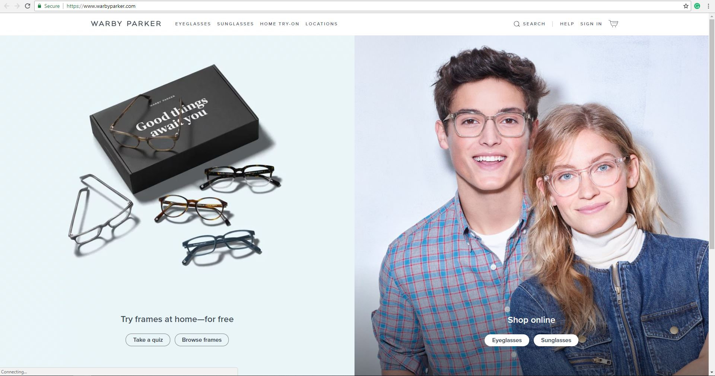

Slide 6
Quiz Funnel

Slide 7
1.1 Quiz Funnel
To help users find their perfect frame, Warby Parker has a Style Quiz that has the following 6 questions:

Slide 8
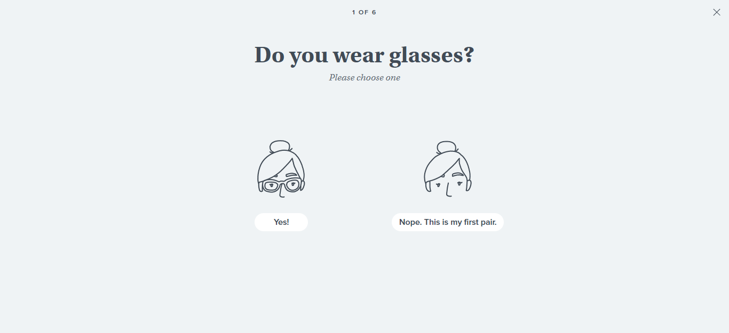

Slide 9
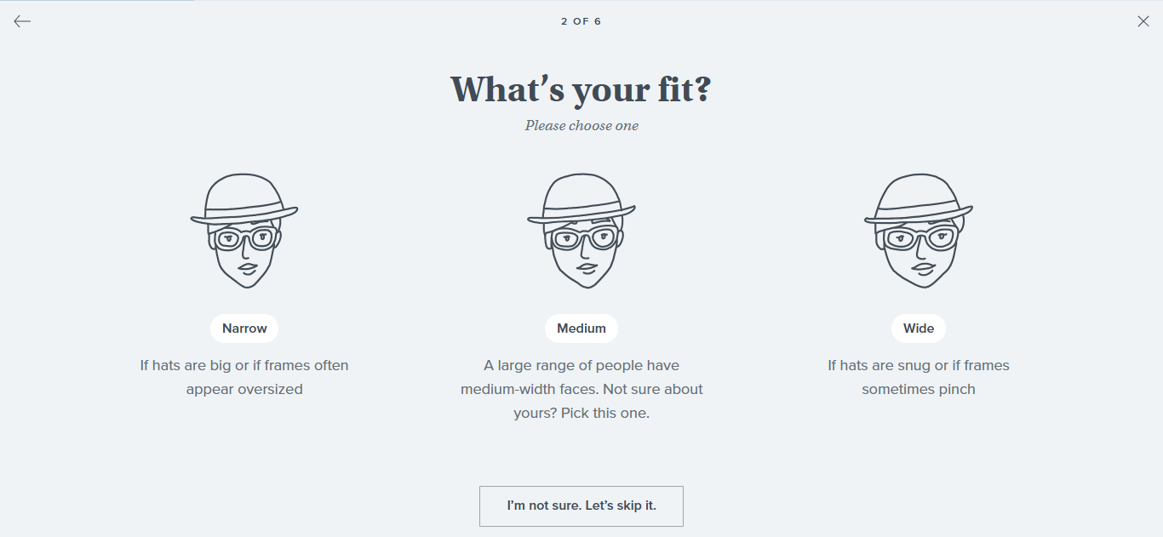

Slide 10
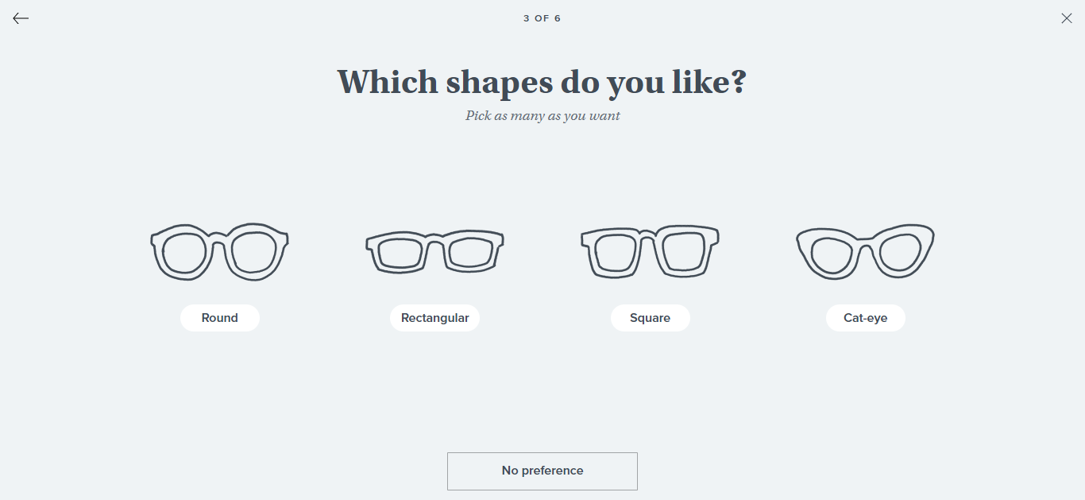

Slide 11
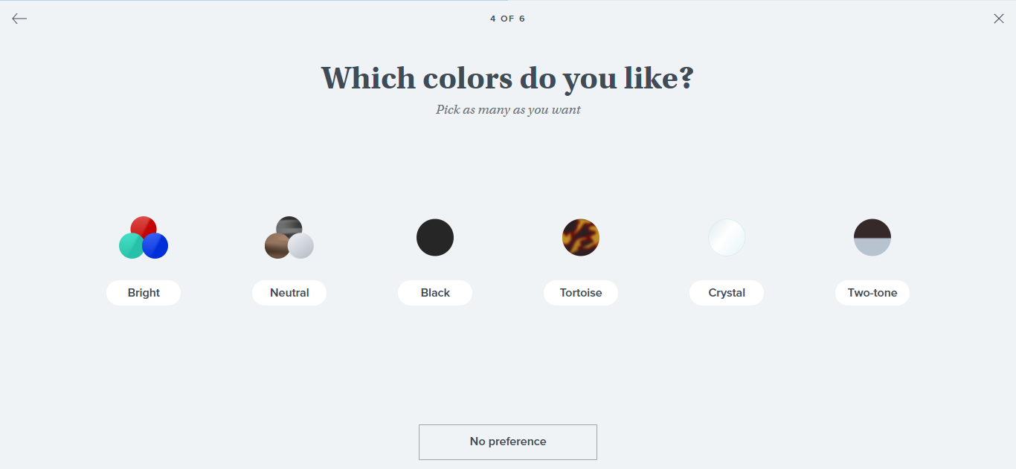

Slide 12
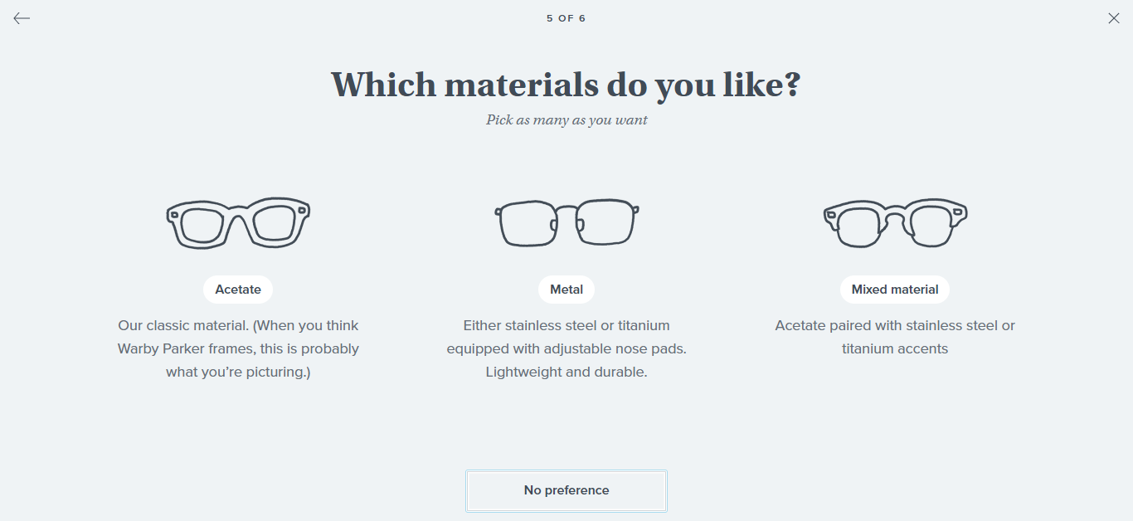

Slide 13
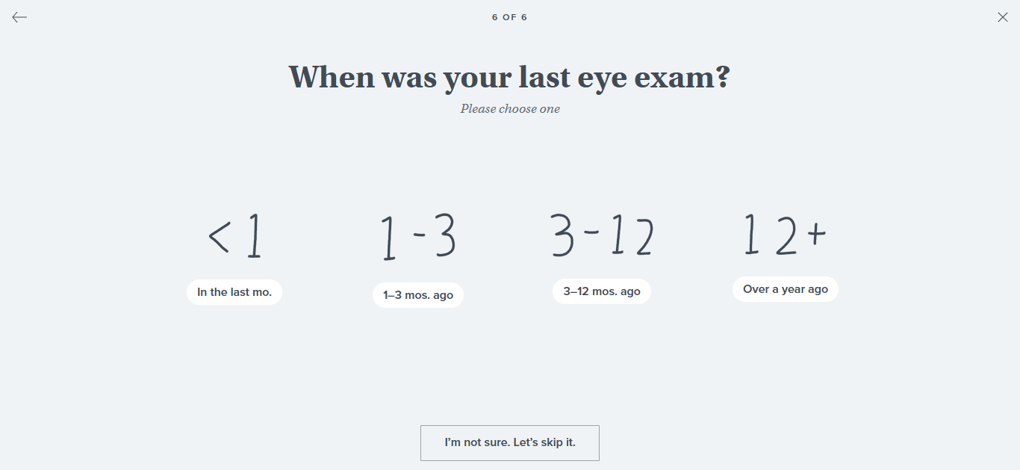

Slide 14
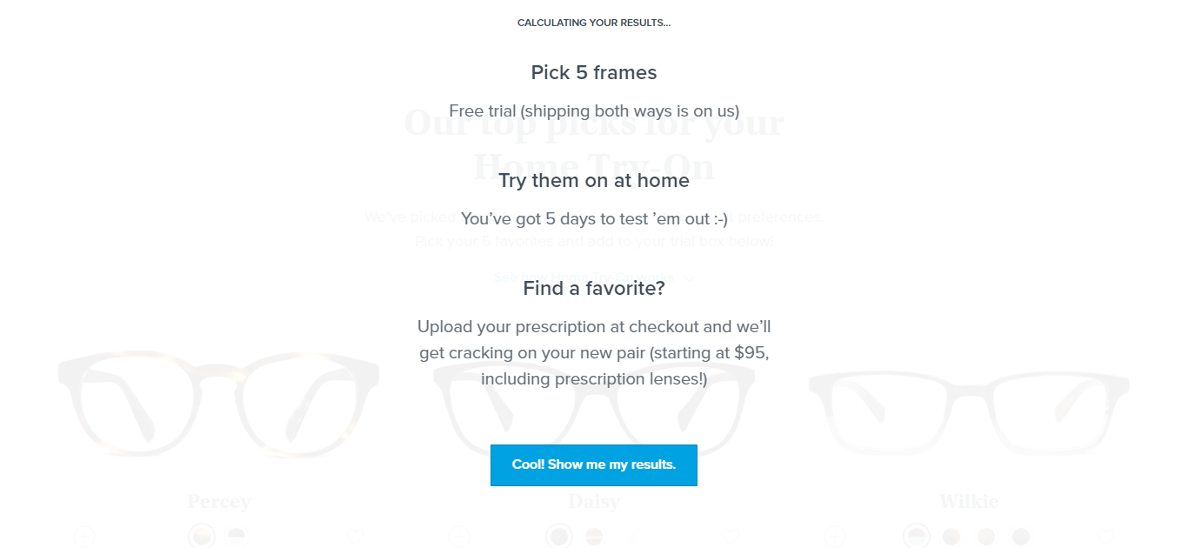

Slide 15
Project Objective
In this Capstone Project, I will analyze different Warby Parker's marketing funnels in order to calculate conversion rates.

Slide 16
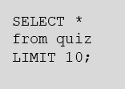
1.1 Quiz Funnel
By selecting all columns from the first 10 rows, I can see what columns the table has.
User_id | style | fit | shape | color
4e8118dc-bb3d-49bf-85fc-cca8d83232ac | Women's Styles | Medium | Rectangular | Tortoise
291f1cca-e507-48be-b063-002b14906468 | Women's Styles | Narrow | Round | Black
75122300-0736-4087-b6d8-c0c5373a1a04 | Women's Styles | Wide | Rectangular | Two-Tone
75bc6ebd-40cd-4e1d-a301-27ddd93b12e2 | Women's Styles | Narrow | Square | Two-Tone
ce965c4d-7a2b-4db6-9847-601747fa7812 | Women's Styles | Wide | Rectangular | Black
28867d12-27a6-4e6a-a5fb-8bb5440117ae | Women's Styles | Narrow | Rectangular | Black
5a7a7e13-fbcf-46e4-9093-79799649d6c5 | Women's Styles | Wide | Rectangular | Tortoise
0143cb8b-bb81-4916-9750-ce956c9f9bd9 | Women's Styles | Wide | Rectangular | Two-Tone
a4ccc1b3-cbb6-449c-b7a5-03af42c97433 | Women's Styles | I'm not sure. Let's skip it. | Square | Tortoise
b1dded76-cd60-4222-82cb-f6d464104298 | Women's Styles | Narrow | Rectangular | Crystal

Slide 17
1.2 Quiz Funnel
Users will "give up" at different points in the survey. We can analyze how many users move from Question 1 to Question 2, etc.
By creating a quiz funnel using the GROUP BY command, we can see the number of responses for each question. Looks like 500 people started the quiz, and 270 ended it.
SELECT question,
COUNT(DISTINCT user_id)
FROM survey
GROUP BY question;
question | COUNT(DISTINCT user_id)
1. What are you looking for? | 500
2. What's your fit? | 475
3. Which shapes do you like? | 380
4. Which colors do you like? | 361
5. When was your last eye exam? | 270

Slide 18
1.3 Quiz Funnel
Using Excel, I calculated the percentage of users who answered each question.
The questions which have lower completion rates are #3 and #5.
This is likely because users may not want to limit their options by choosing a shape, and they may not remember when they last had an eye exam.
question | COUNT(DISTINCT user_id) | Percent Completing this question | Percent of total visitors (500)
1. What are you looking for? | 500 | 100% | 100%
2. What's your fit? | 475 | 95% | 95%
3. Which shapes do you like? | 380 | 80% | 76%
4. Which colors do you like? | 361 | 95% | 72%
5. When was your last eye exam? | 270 | 75% | 54%

Slide 19
Home Try-On Funnel

Slide 20
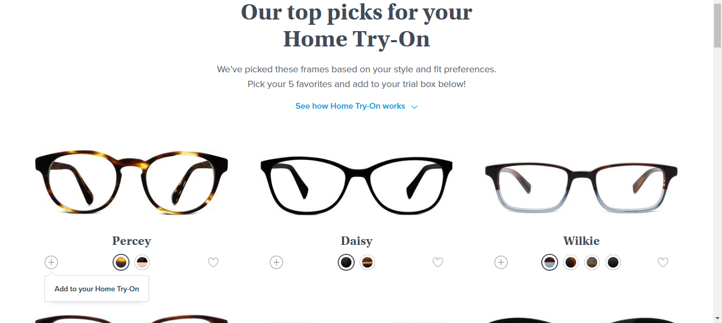
After taking the quiz, users are encouraged to try 3 or 5 pairs at home before selecting the perfect pair to keep and wear.

Slide 21
Warby Parker’s “purchase funnel” is: Take the Style Quiz → Home Try-On → Purchase the Perfect Pair of Glasses During the Home Try-On stage, we will be conducting an A/B Test: 50% of the users will get 3 pairs to try on 50% of the users will get 5 pairs to try on

Slide 22
2.1 Home Try-On Funnel
SELECT *
FROM quiz
LIMIT 5;
SELECT *
FROM home_try_on
LIMIT 5;
SELECT *
FROM purchase
LIMIT 5;
Let's find out whether or not users who get more pairs to try on at home will be more likely to make a purchase.
The data will be distributed across three tables: quiz, home_try_on, and purchase.
By running multiple queries, we can examine the first five rows of each table.

Slide 23
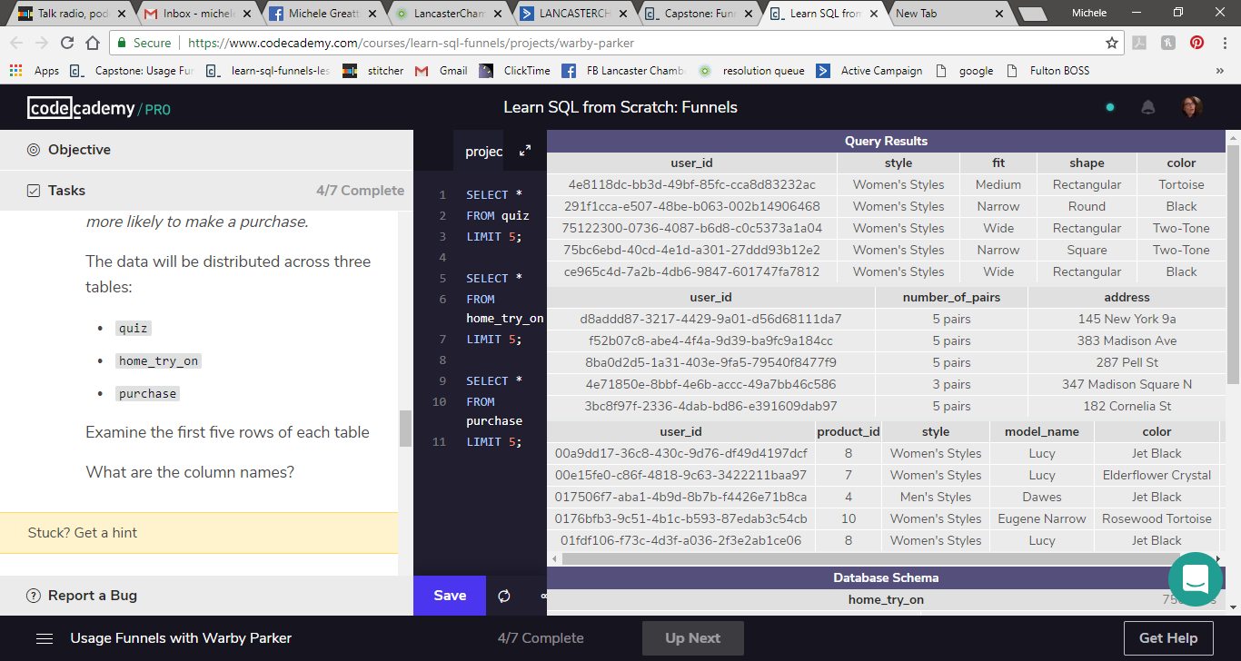
Query Results
Table: quiz
Table: home_try_on
Table: purchase

Slide 24
2.2 Home Try-On Funnel
To create a new table with the following layout, we will need to use a LEFT JOIN to combine the three tables, starting with the browse and end with the purchase.
user_id | Is_home_try_on | Number_of_pairs | Is_purchase
4e8118dc | True | 3 | False
291f1cca | True | 5 | False
75122300 | False | NULL | Fasle

Slide 25
Code, part one
SELECT DISTINCT q.user_id,
h.user_id IS NOT NULL AS 'is_home_try_on',
h.number_of_pairs,
p.user_id IS NOT NULL AS 'is_purchase'
FROM quiz q
LEFT JOIN home_try_on h
ON q.user_id = h.user_id
LEFT JOIN purchase p
ON p.user_id = q.user_id
LIMIT 10;

Slide 26
Each row will represent a single user from the browse table: - If the user has any entries in home_try_on, then is_home_try_on will be 'True’. - number_of_pairs comes from home_try_on table - If the user has any entries in is_purchase, then is_purchase will be 'True'.

Slide 27
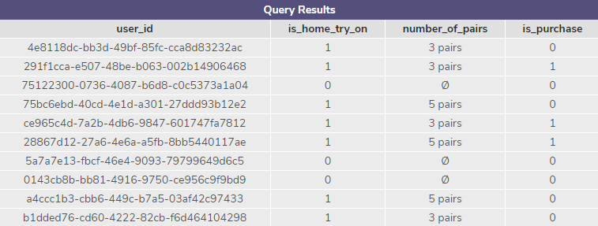
Query Results

Slide 28
Code, part two
with funnels AS (
SELECT DISTINCT q.user_id,
h.user_id IS NOT NULL AS 'is_home_try_on',
h.number_of_pairs,
p.user_id IS NOT NULL AS 'is_purchase'
FROM quiz q
LEFT JOIN home_try_on h
ON q.user_id = h.user_id
LEFT JOIN purchase p
ON p.user_id = q.user_id)
SELECT COUNT(*) AS 'Number_of_pairs',
SUM(is_home_try_on) AS 'Try_On',
SUM(is_purchase) AS 'num_purchase',
1.0 * SUM(is_home_try_on) / COUNT(user_id) AS 'HOME_TRY_ON',
1.0 * SUM(is_purchase) / SUM(is_home_try_on) AS ‘try_on_to_purchase'
FROM funnels;

Slide 29
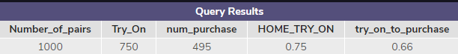
Query Results

Slide 30
What does it all mean?

Slide 31
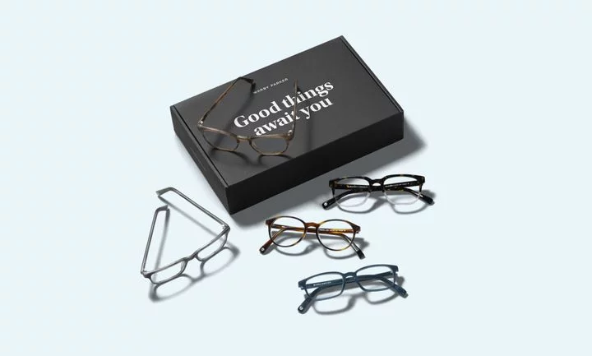
Analysis:: actionable insight
Using what we found, we can calculate conversion rates by aggregating across all rows

Slide 32
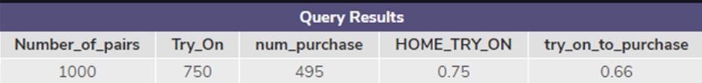

Analysis:: actionable insight
From quiz to try-on:
We had 1,000 to start, 750 pairs were tried on at home. (75%)

Slide 33
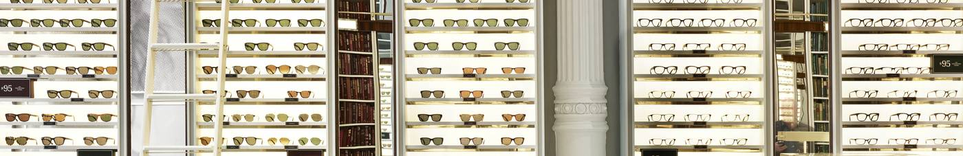
Analysis:: actionable insight
From home_try_on to purchase:
Of those 750 that were tried, 495 were purchased (66%)

Slide 34
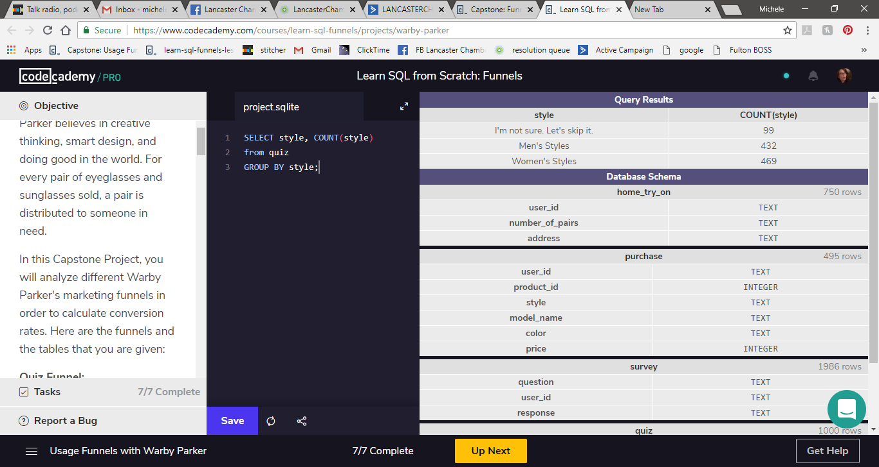
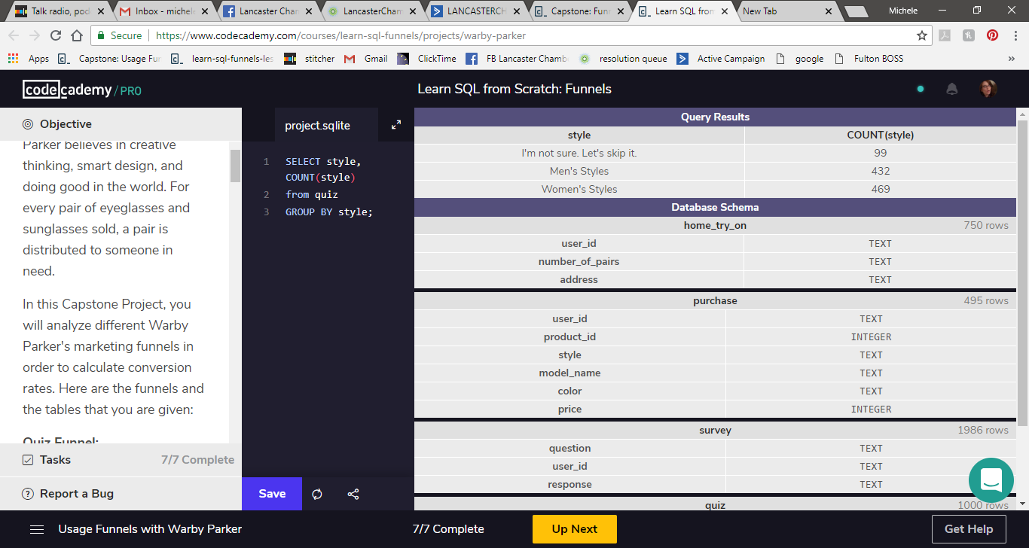
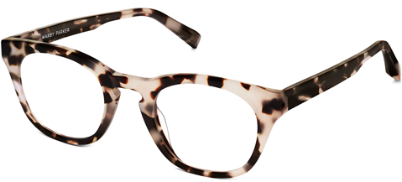
Analysis:: actionable insight
We can also use the original tables to calculate things like:
The most common results of the style quiz.

Slide 35
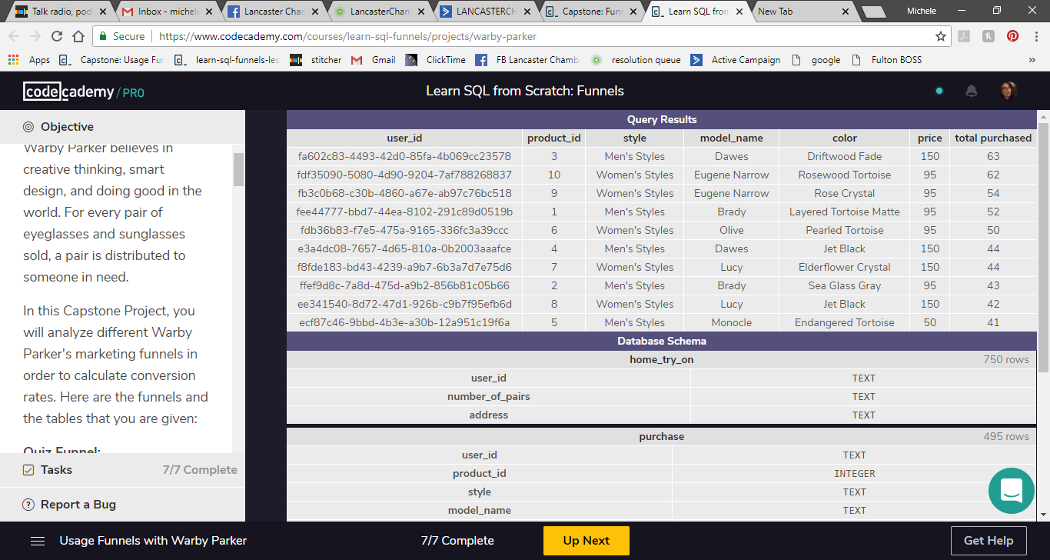
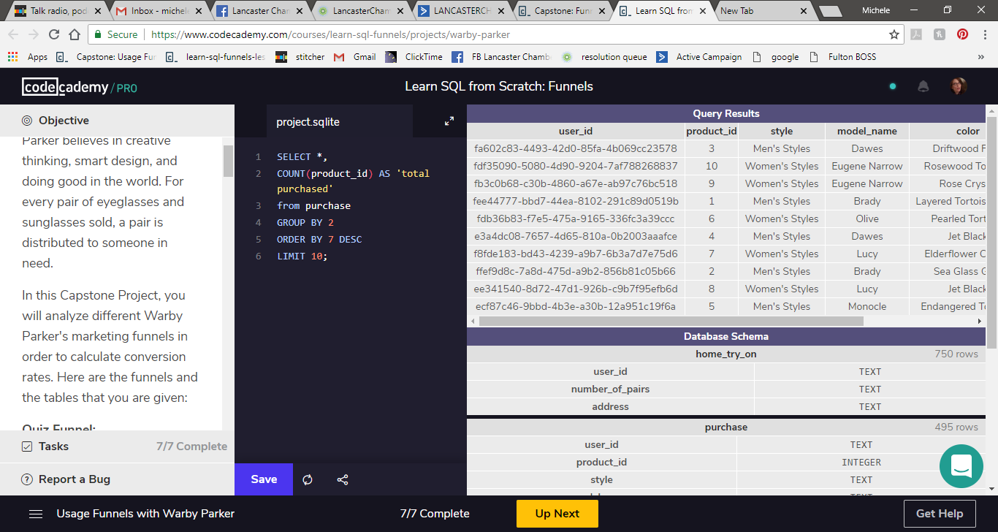
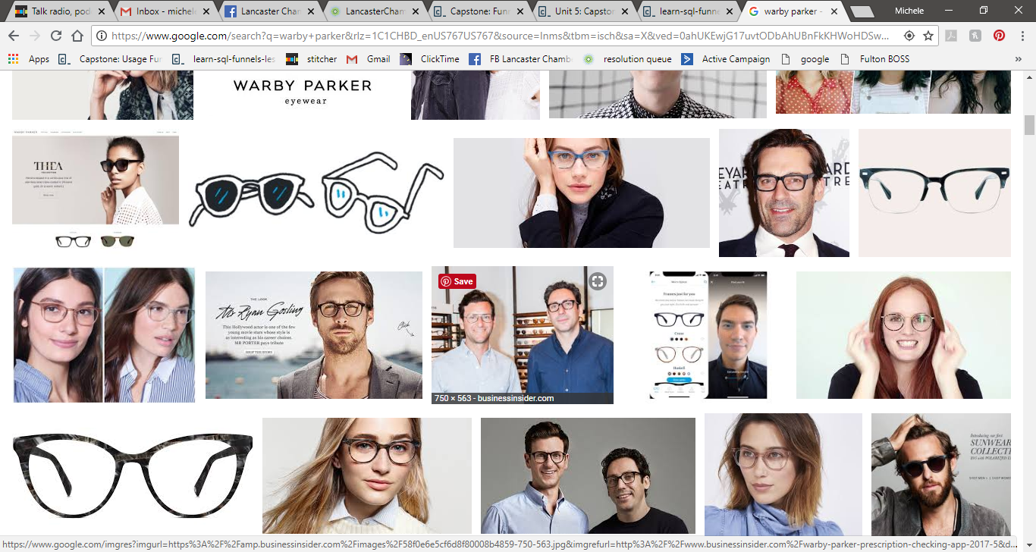

Analysis:: actionable insight
The top ten most common types of purchase made.

